Slide 1
Processor Design:
Datapath and control
:
Notes:
Please if anyone has additional comments please speak up

Slide 2
The Performance Perspective
Recall, performance is determined by:
  Instruction count
  Clock cycles per instruction (CPI)
  Clock cycle time
Processor design will affect
  Clock cycles per instruction
  Clock cycle time
Single cycle datapath and control design:
  Advantage: One clock cycle per instruction
  Disadvantage: long cycle time
I-Count
CPI
Cycle
Notes:
This slide shows how the next two lectures fit into the overall performance picture.
Recalled from one of your earlier lectures that the performance of a machine is determined by 3 factors: (a) Instruction count, (b) Clock cycle time, and (c) Clock cycles per instruction.
Instruction count is controlled by the Instruction Set Architecture and the compiler design so the computer engineer has very little control over it (Instruction Count).
What you as a computer engineer can control, while you are designing a processor, are the Clock Cycle Time and Instruction Count per cycle.
More specifically, in the next two lectures, you will be designing a single cycle processor which by definition takes one clock cycle to execute every instruction.
The disadvantage of this single cycle processor design is that it has a long cycle time.
+2 = 7 min. (X:47)

Slide 3
Designing a Processor: Step-by-Step
Analyze instruction set => datapath requirements
  The meaning of each instruction is given by the register transfers
  Datapath must include storage elements for ISA registers
  Datapath must support each register transfer
Select datapath components and clocking methodology
Assemble datapath meeting the requirements
Analyze implementation of each instruction
  Determine the setting of control signals for register transfer
Assemble the control logic

Slide 4
Review of MIPS Instruction Formats
All instructions are 32-bit wide
Three instruction formats: R-type, I-type, and J-type
  Op⁶: 6-bit opcode of the instruction
  Rs⁵, Rt⁵, Rd⁵: 5-bit source and destination register numbers
  sa⁵: 5-bit shift amount used by shift instructions
  funct⁶: 6-bit function field for R-type instructions
  immediate¹⁶: 16-bit immediate value or address offset
  immediate²⁶: 26-bit target address of the jump instruction
Op⁶
Rs⁵
Rt⁵
Rd⁵
sa⁵
funct⁶
Op⁶
Rs⁵
Rt⁵
immediate¹⁶
Op⁶
immediate²⁶

Slide 5
MIPS Subset of Instructions
Only a subset of the MIPS instructions are considered
  ALU instructions (R-type): add, sub, and, or, xor, slt
  Immediate instructions (I-type): addi, slti, andi, ori, xori
  Load and Store (I-type): lw, sw
  Branch (I-type): beq, bne
  Jump (J-type): j
This subset does not include all the integer instructions
But sufficient to illustrate design of datapath and control
Concepts used to implement the MIPS subset are used to construct a broad spectrum of computers

Slide 6
Details of the MIPS Subset
Instruction | Meaning | Format
add rd, rs, rt | addition | op⁶ = 0 | rs⁵ | rt⁵ | rd⁵ | 0 | 0x20
sub rd, rs, rt | subtraction | op⁶ = 0 | rs⁵ | rt⁵ | rd⁵ | 0 | 0x22
and rd, rs, rt | bitwise and | op⁶ = 0 | rs⁵ | rt⁵ | rd⁵ | 0 | 0x24
or rd, rs, rt | bitwise or | op⁶ = 0 | rs⁵ | rt⁵ | rd⁵ | 0 | 0x25
xor rd, rs, rt | exclusive or | op⁶ = 0 | rs⁵ | rt⁵ | rd⁵ | 0 | 0x26
slt rd, rs, rt | set on less than | op⁶ = 0 | rs⁵ | rt⁵ | rd⁵ | 0 | 0x2a
addi rt, rs, im¹⁶ | add immediate | 0x08 | rs⁵ | rt⁵ | im¹⁶
slti rt, rs, im¹⁶ | slt immediate | 0x0a | rs⁵ | rt⁵ | im¹⁶
andi rt, rs, im¹⁶ | and immediate | 0x0c | rs⁵ | rt⁵ | im¹⁶
ori rt, rs, im¹⁶ | or immediate | 0x0d | rs⁵ | rt⁵ | im¹⁶
xori rt, rs, im¹⁶ | xor immediate | 0x0e | rs⁵ | rt⁵ | im¹⁶
lw rt, im¹⁶(rs) | load word | 0x23 | rs⁵ | rt⁵ | im¹⁶
sw rt, im¹⁶(rs) | store word | 0x2b | rs⁵ | rt⁵ | im¹⁶
beq rs, rt, im¹⁶ | branch if equal | 0x04 | rs⁵ | rt⁵ | im¹⁶
bne rs, rt, im¹⁶ | branch not equal | 0x05 | rs⁵ | rt⁵ | im¹⁶
j im²⁶ | jump | 0x02 | im²⁶

Slide 7
Register Transfer Level (RTL)
RTL is a description of data flow between registers
RTL gives a meaning to the instructions
All instructions are fetched from memory at address PC
Instruction RTL Description
ADD Reg(Rd) ← Reg(Rs) + Reg(Rt); PC ← PC + 4
SUB Reg(Rd) ← Reg(Rs) – Reg(Rt); PC ← PC + 4
ORI Reg(Rt) ← Reg(Rs) | zero_ext(Im16); PC ← PC + 4
LW Reg(Rt) ← MEM[Reg(Rs) + sign_ext(Im16)]; PC ← PC + 4
SW MEM[Reg(Rs) + sign_ext(Im16)] ← Reg(Rt); PC ← PC + 4
BEQ if (Reg(Rs) == Reg(Rt))
PC ← PC + 4 + 4 × X , where X is ( sign_extend(Im16))
else PC ← PC + 4

Slide 8
Steps to Execute Instructions
1. Fetch the instruction from memory pointed by program counter (PC)
2. Decode instruction – to find out what to perform
Meanwhile, read source registers specified in the instruction fields
  lw and sw instructions require reading only one register
  But, most other instructions require reading two registers
3. Perform the operation required by the instruction using the ALU
  Arithmetic & logical instructions
  Memory-reference instructions: use ALU for address calculation
  Conditional branch instructions: use ALU for comparison
4. Memory access: lw and sw instructions
5. Write back the result to destination register
Increment PC by 4 or change PC to branch target address

Slide 9
Instructions are Executed in Steps
R-type Fetch instruction: Instruction ← MEM[PC]
Fetch operands: data1 ← Reg(Rs), data2 ← Reg(Rt)
Execute operation: ALU_result ← func(data1, data2)
Write ALU result: Reg(Rd) ← ALU_result
Next PC address: PC ← PC + 4
I-type Fetch instruction: Instruction ← MEM[PC]
Fetch operands: data1 ← Reg(Rs), data2 ← Extend(imm16)
Execute operation: ALU_result ← op(data1, data2)
Write ALU result: Reg(Rt) ← ALU_result
Next PC address: PC ← PC + 4
BEQ Fetch instruction: Instruction ← MEM[PC]
Fetch operands: data1 ← Reg(Rs), data2 ← Reg(Rt)
Equality: zero ← subtract(data1, data2)
Branch: if (zero) PC ← PC + 4 + 4×sign_ext(imm16)
else PC ← PC + 4

Slide 10
Instruction Execution – cont’d
LW Fetch instruction: Instruction ← MEM[PC]
Fetch base register: base ← Reg(Rs)
Calculate address: address ← base + sign_extend(imm16)
Read memory: data ← MEM[address]
Write register Rt: Reg(Rt) ← data
Next PC address: PC ← PC + 4
SW Fetch instruction: Instruction ← MEM[PC]
Fetch registers: base ← Reg(Rs), data ← Reg(Rt)
Calculate address: address ← base + sign_extend(imm16)
Write memory: MEM[address] ← data
Next PC address: PC ← PC + 4
Jump Fetch instruction: Instruction ← MEM[PC]
Target PC address: target ← PC[31:28] || Imm26 || ‘00’
Jump: PC ← target

Slide 11
Computer Architectures
Princeton (Von Neumann) Architecture
  All memory space on same bus
  Instructions and data treated in same way
    Possible bottleneck between instruction fetches and data fetches
  Simple processor design
    Only one memory interface
    More reliable since fewer things can fail
    RAM used for both data and instructions . Greater flexibility in SW/OS design

Slide 12
Computer Architectures ~
Harvard Architecture
– Code and data memory storage areas are on different busses
  Potentially more efficient
  Instructions execute in fewer cycles
    Instructions and data can be fetched simultaneously
    Greater instruction parallelism
  More complex processor design

Slide 13
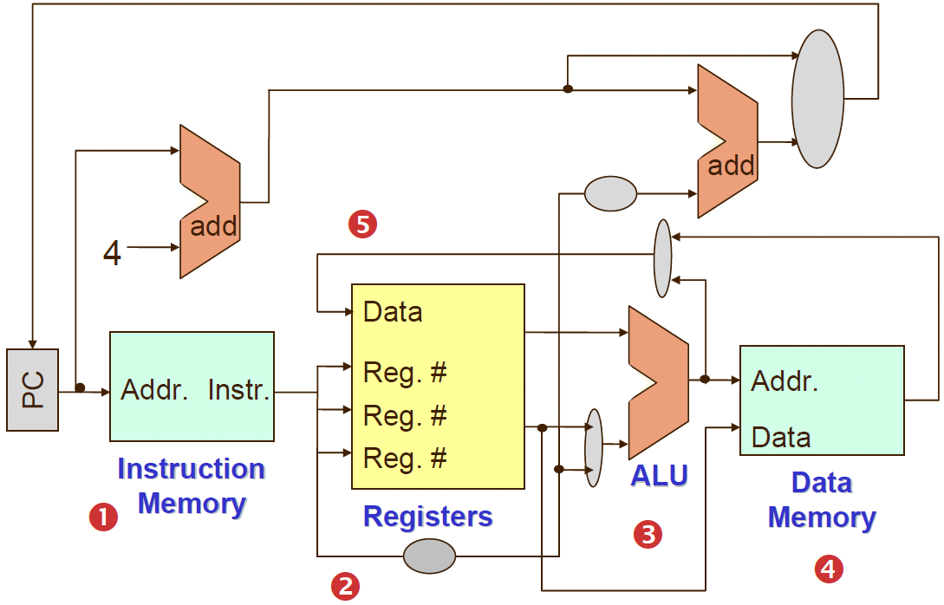
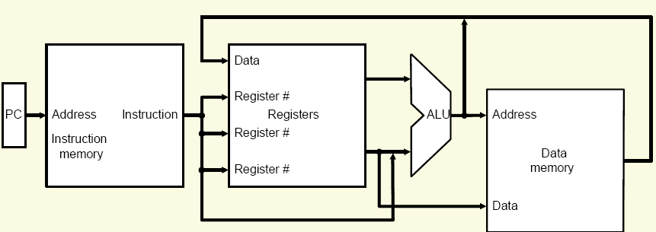
Brief Overview of MIPS Processor Implementation

Slide 14
Logic Design – need a refreshment!!!
MIPS computers are designed using both combinational and sequential logic circuits.
Combinational logic circuits: circuits whose output only depend on the current inputs
Sequential logic circults are circuits whose output depends on both the current input and the value stored in memory (called state).
A clock is a free-running signal with a fixed cycle time (or called clock period) or, equivalently, a fixed clock frequency (i.e., inverse of the cycle time). Clocks are needed in sequential logic to decide when an element that contains state should be updated.
Edge-triggered clocking: rising edge vs. falling edge).
Clocked systems are also called synchronous systems.
A signal that is logically high is called asserted
A signal that is logically low is called deasserted

Slide 15
Requirements of the Instruction Set
Memory
  Instruction memory where instructions are stored
  Data memory where data is stored
Registers
  31 × 32-bit general purpose registers, R0 is always zero
  Read source register Rs
  Read source register Rt
  Write destination register Rt or Rd
Program counter PC register and Adder to increment PC
Sign and Zero extender for immediate constant
ALU for executing instructions

Slide 16
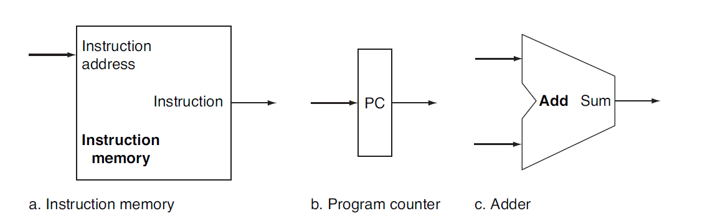
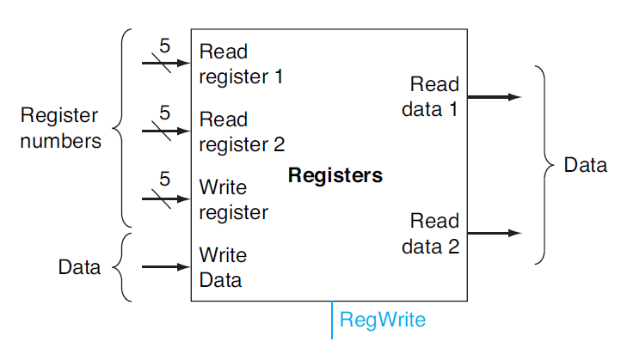
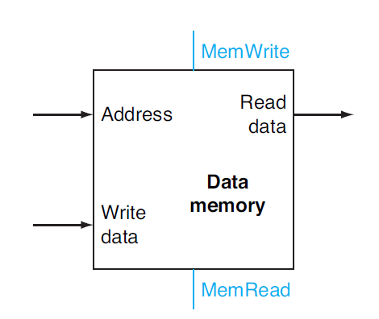
Components of the Datapath
Combinational Elements
  ALU, Adder
  Immediate extender
  Multiplexers
Storage Elements
  Instruction memory
  Data memory
  PC register
  Register file
Clocking methodology
  Timing of writes
d-Register file
e-Data memory unit

Slide 17
Register File
A register file is a structure consisting of a set of registers
  i.e. built from an array of D flip-flops
  Can be read and written by supplying a register number
  Reads and writes go through ports; i.e. read port and write port
Reading a register:
  Input: a register number
  Output: data contained in the specified register
Writing a register:
  Inputs: a register number, the data to write
  Output: .

Slide 18
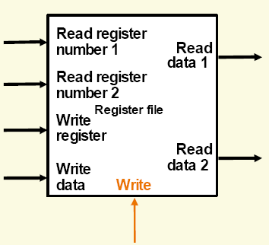
A Register File with Two Read Ports and One Write Port
There are five inputs and two outputs.
The read ports can be implemented with a pair of multiplexors,
  each of which is as wide as the number of bits in the register file.

Slide 19
MIPS Register File
Register File consists of 32 × 32-bit registers
  Read data 1 and Read data 2 : 32-bit output busses for reading 2 registers
  Write Data : 32-bit input bus for writing a register when RegWrite is 1
  Two registers read and one written in a cycle
Registers are selected by:
  Read register 1 selects register to be read on Read data 1
  Read register 2 selects register to be read on Read data 2
  Write register selects the register to be written , destination register

Slide 20
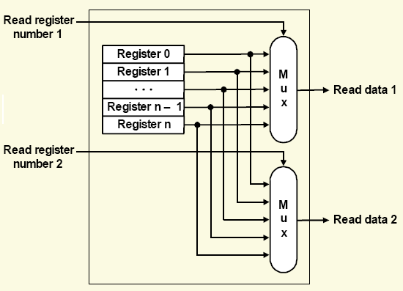
Implementation of Two Read Ports
To implement two read ports for a register file with n registers, we use two n-to-1 multiplexors, each of which is 32 bits wide.
The read register number signal is used as the multiplexor selector signal.

Slide 21
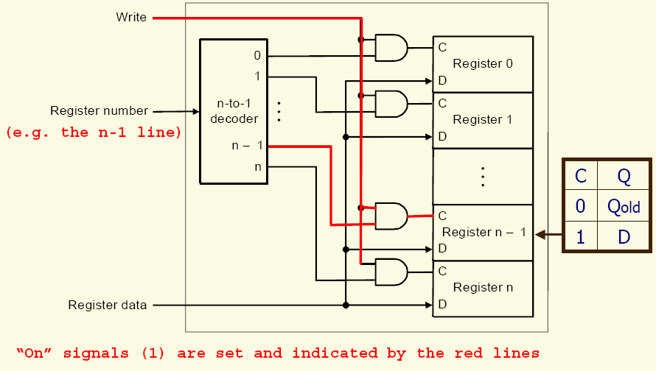
Implementation of a Write Port
To implement the write port for a register file with n registers, we use an n-to-1 decoder to generate a signal that can be used to determine which register to write.

Slide 22
SRAMs and DRAMs
Unlike registers which are small, fast memories inside the processor, larger amounts of memory are in the form of:
  Static random access memories (SRAMs)
  Dynamic random access memories (DRAMs)
SRAMs are usually used for relatively small memories (e.g., cache) while DRAMs are used for larger memories (e.g., main memory).
SRAMs are typically built using flip-flops while DRAMs are built using capacitors.
SRAMs are somewhat simpler in design than DRAMs, but they are also more expensive and less dense.

Slide 23
DRAMs
  The value kept in a cell is stored as a charge in a capacitor.
  Only a single transistor is needed to access the stored charge (either to read the value or to overwrite the charge stored there), and hence DRAMs are much denser and cheaper per bit.
  Since the charge is stored on a capacitor, it cannot be kept indefinitely but has to be refreshed periodically.
  To refresh a cell, we read its content and then write it back.
  Typically, refresh operations consume 1-2% of the active cycles, leaving 98-99% of the cycles available for reading and writing data.
Synchronous RAMs
  Synchronous SRAMs (SSRAMs) and synchronous DRAMs (SDRAMs)
  The key capability provided by synchronous RAMs is the ability to transfer a burst of data from a series of sequential addresses within an array or row. The burst is defined by a starting address, supplied in the usual fashion, and a burst length.
  The speed advantage of synchronous RAMs comes from the ability to transfer the bits in the burst without having to specify additional address bits. Instead, a clock is used to transfer the successive bits in the burst.

Slide 24
Endianess and Alignment
Two conventions for memory ordering – ordering bytes within a word
  Big Endian: address of most significant byte = word address
  (xx00 = Big End of word)
    IBM 360/370, Motorola 68k, MIPS, Sparc, HP PA
  Little Endian:address of least significant byte = word address
  (xx00 = Little End of word)

Slide 25
Byte Ordering Examples
Store 87654321 at address 0x0000, byte-addressable
BIG ENDIAN
LITTLE ENDIAN
0x0000
87
Lower
Memory
Address
0x0000
21
Lower
Memory
Address
0x0001
65
0x0001
43
0x0002
43
0x0002
65
0x0003
21
0x0003
87
Higher
Memory
Address
Higher
Memory
Address

Slide 26
Memory as Words
20
16
12
8
4
0
01001000 11010100 01111001 11010001
11010111 01011010 10000100 00001000
01001010 11001010 01000111 01000000
00000000 00000000 00000000 00000000
00000000 00000000 00000000 00000100 01001000 11010100 01111001 11010001
Address
Data

Slide 27
Word alignment: Words are aligned in memory if they begin at a byte address that is a multiple of the number of bytes in a word
Example: If a word consists of 4 bytes, then:
Address 0
Byte 0
Address 1
Byte 1
Address 2
Byte 2
Address 3
Byte 3
Address 4
Byte 4
Address 5
Byte 5
Address 6
Byte 6
Address 7
Byte 7
Aligned word
Mis-Aligned word

Slide 28
Building a Datapath

Slide 29
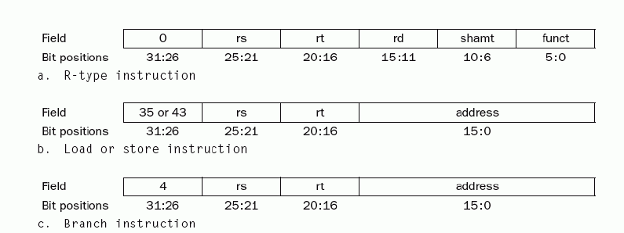
The three instruction classes (R-type, load and store, and branch)

Slide 30
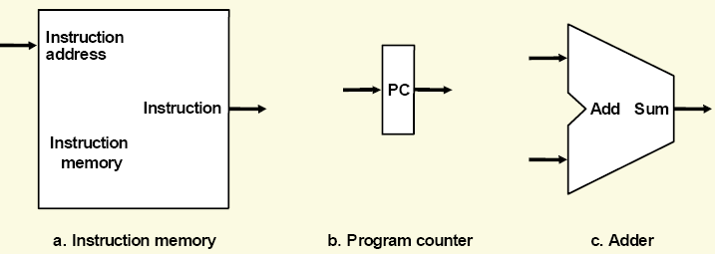
Basic Building blocks
Some basic datapath elements:
Instruction memory: a memory unit that stores the instructions of a program and supplies an instruction given its address.
Program counter: a register that stores the address of the instruction being executed.
Adder: a unit that increments the program counter to the address of the next instruction.

Slide 31
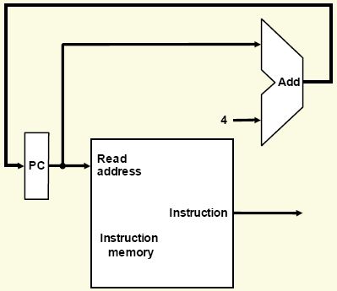
Building a Datapath
To execute any instruction, we first fetch the instruction from memory.
To prepare for executing the next instruction,
we increment the program counter so that it points at the next instruction (4 bytes later).

Slide 32
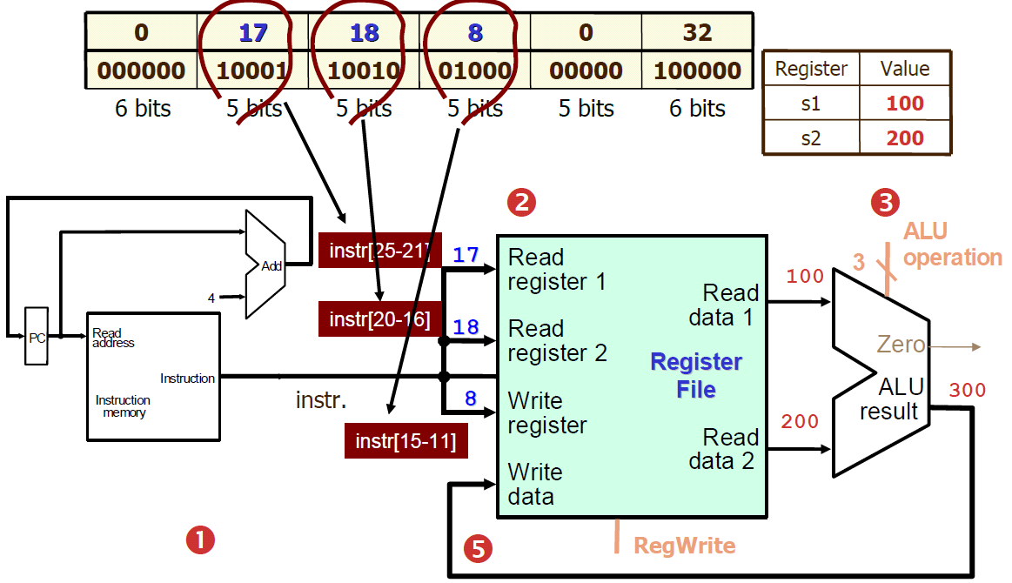
Datapath for Arithmetic-Logical (R-Format) Instr.
E.g.: add $t0, $s1, $s2

Slide 33
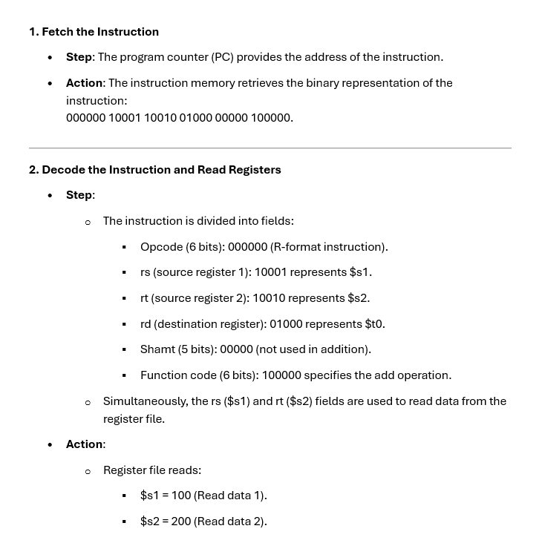

Slide 34
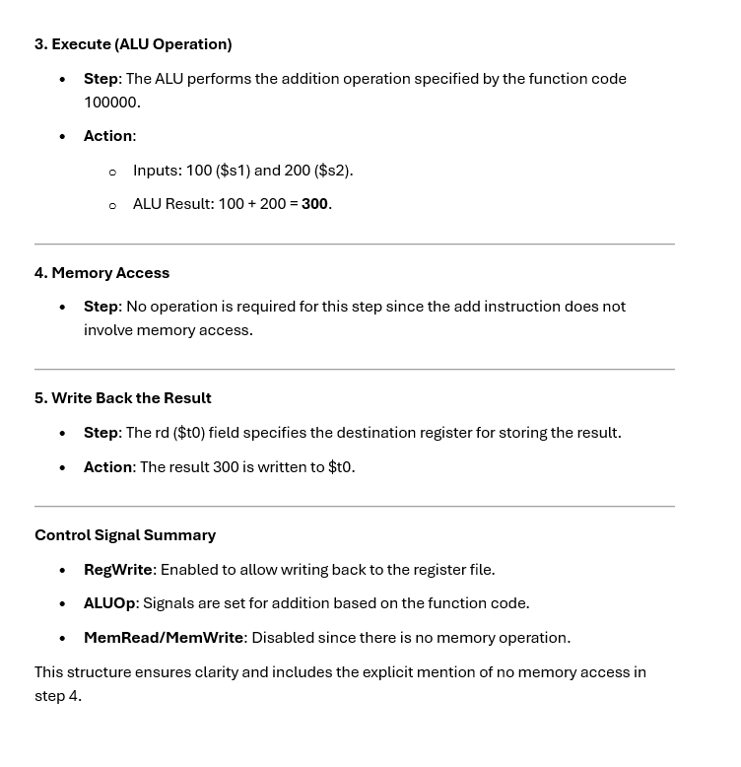

Slide 35
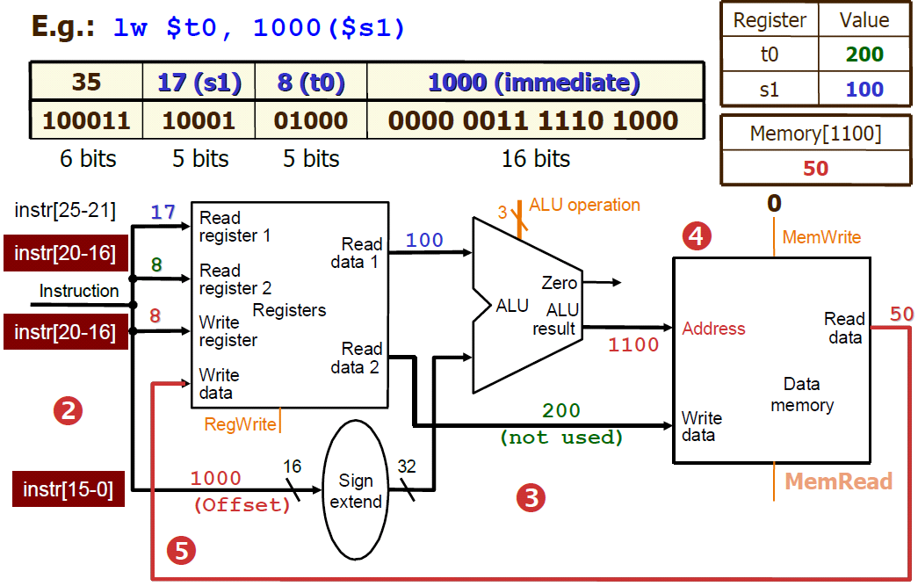
Datapath for Load and Store (I-Format) Instr.
Note: For load word instruction, MemWrite has to be de-asserted so that the memory will not be modified by incoming write data.

Slide 36
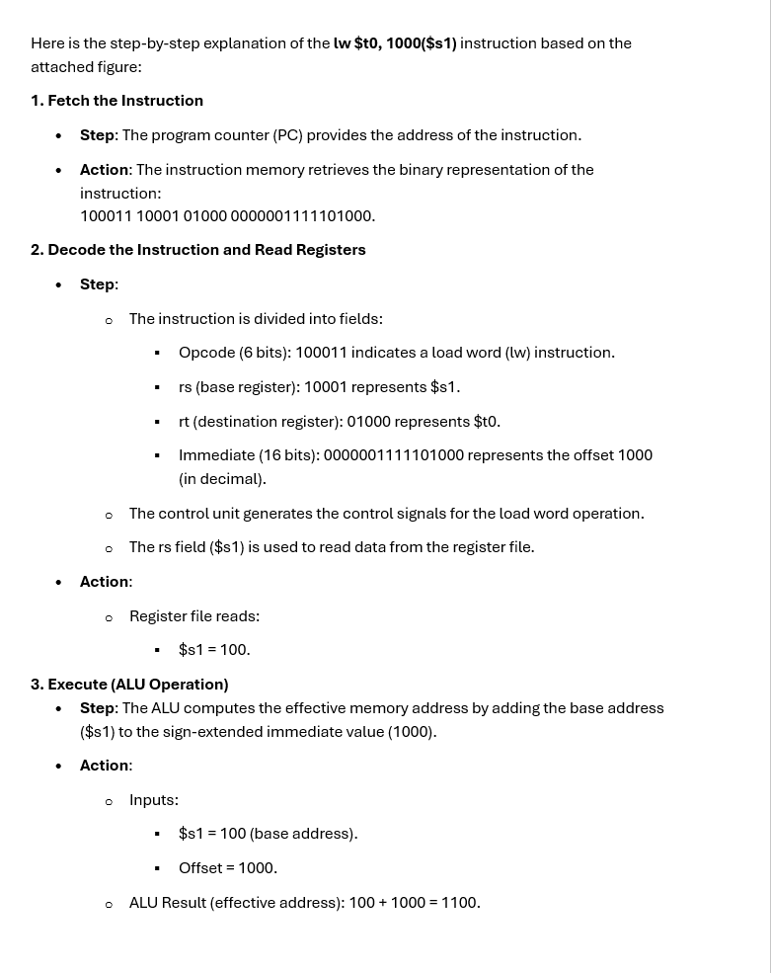

Slide 37
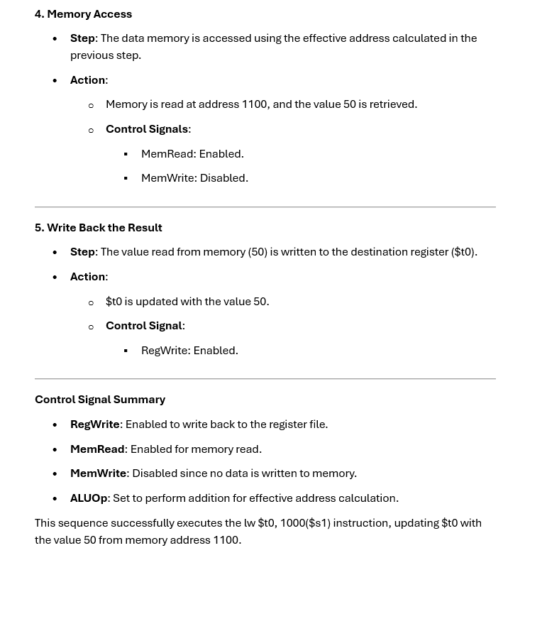

Slide 38
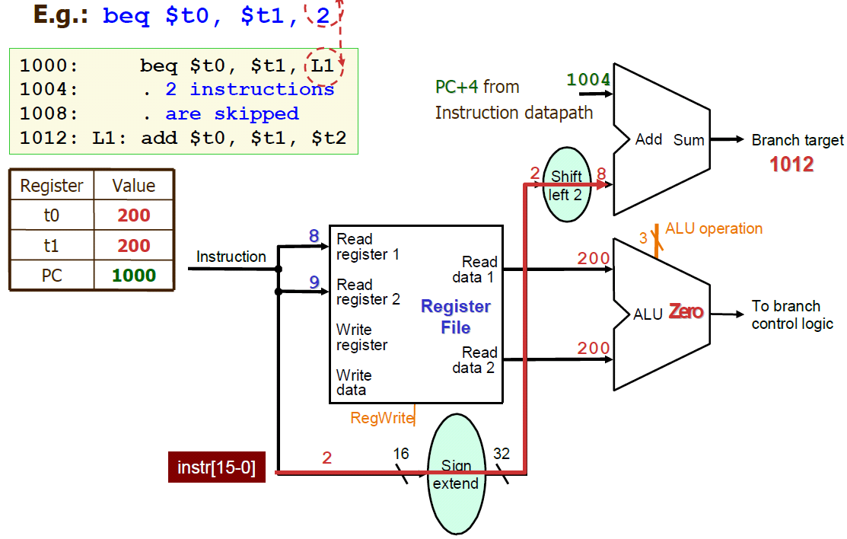
Datapath for Branch (I-Format) Inst.

Slide 39
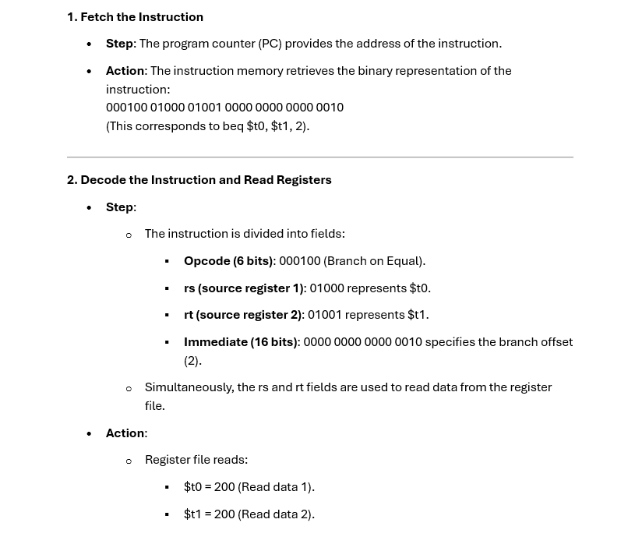

Slide 40
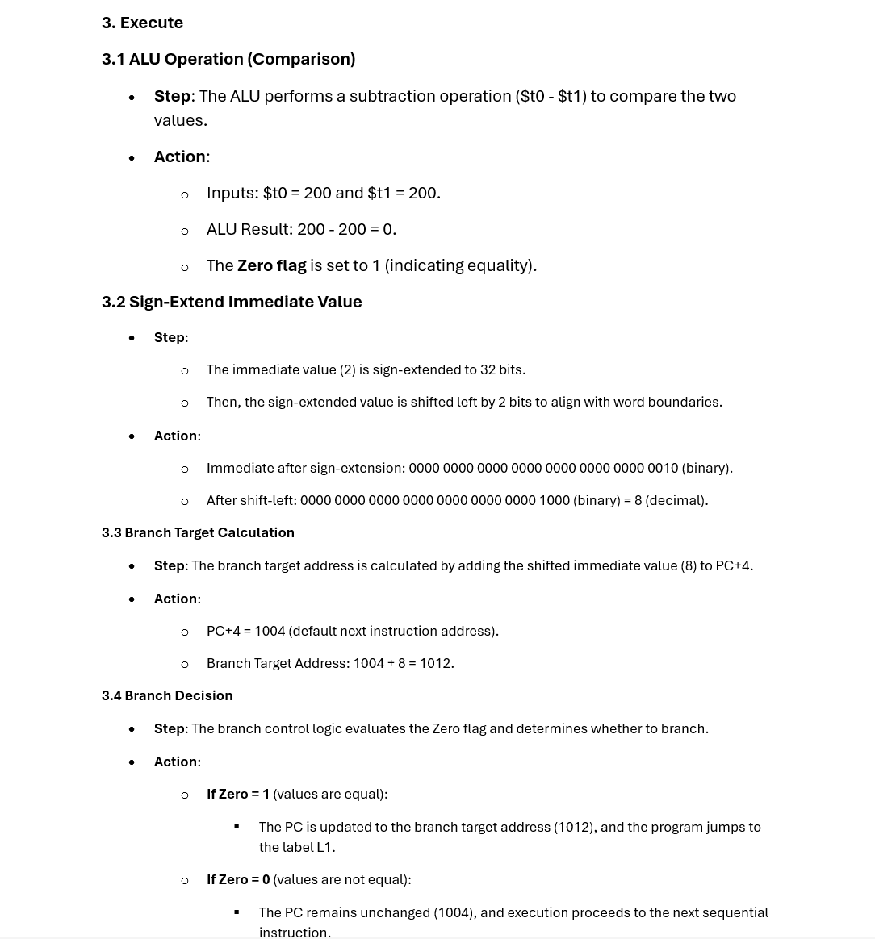

Slide 41
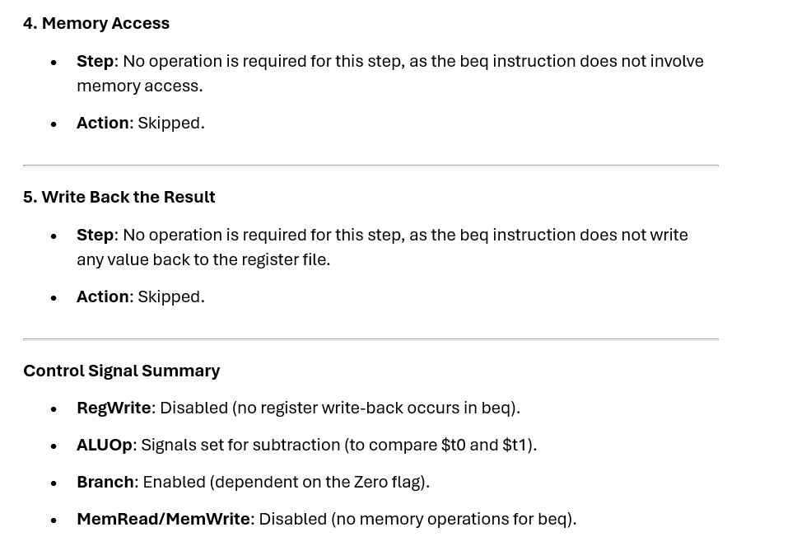

Slide 42
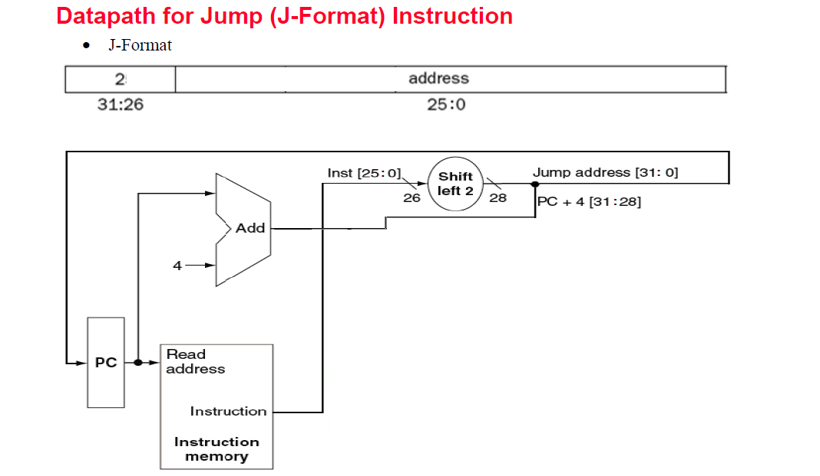

Slide 43
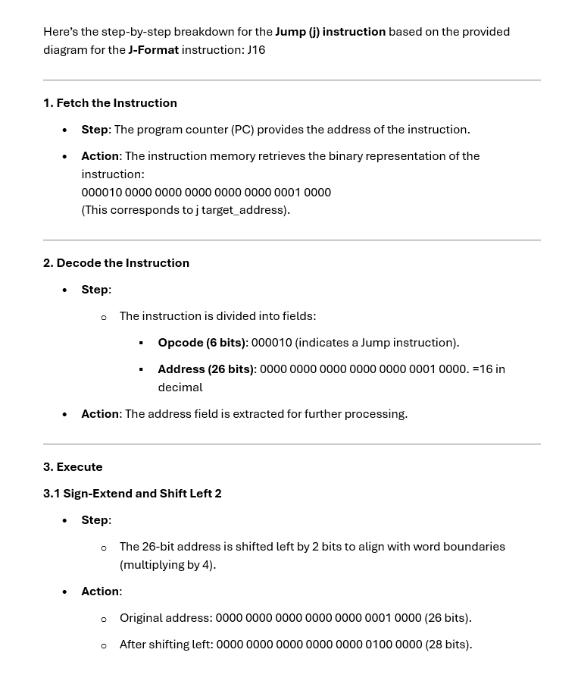

Slide 44
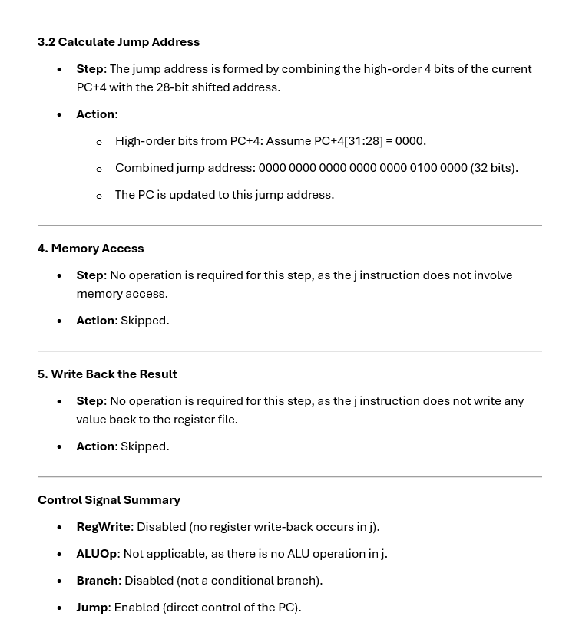

Slide 45
A Simple Single-Cycle Implementation
We have already built a datapath for each instruction separately
Now, we need to combine them into a single datapath
Key to combine: Share some of the resources (e.g., ALU) among different instructions.
This simple implementation is based on the (unrealistic) assumption i.e. all instructions take just one clock cycle each to complete
Implication:
  No datapath resource can be used more than once per instruction
  Any element needed more than once must be duplicated
  → Instructions and data have to be stored in separate memories

Slide 46
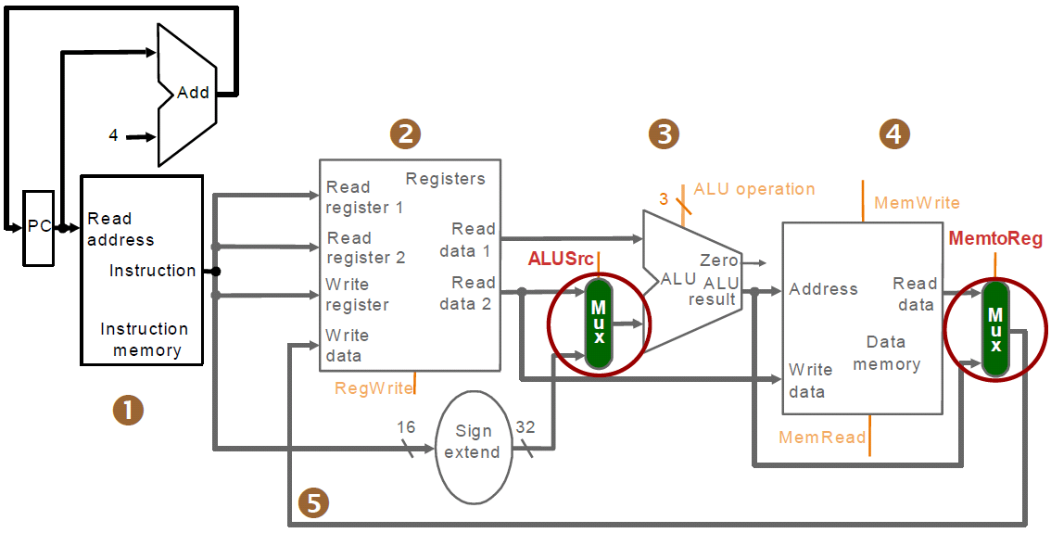
Combined Datapath for R-type Instructions & Memory Instr.
Use ALUSrc to decide which source will be sent to the ALU
Use MemtoReg to choose the source of output back to dest. register

Slide 47
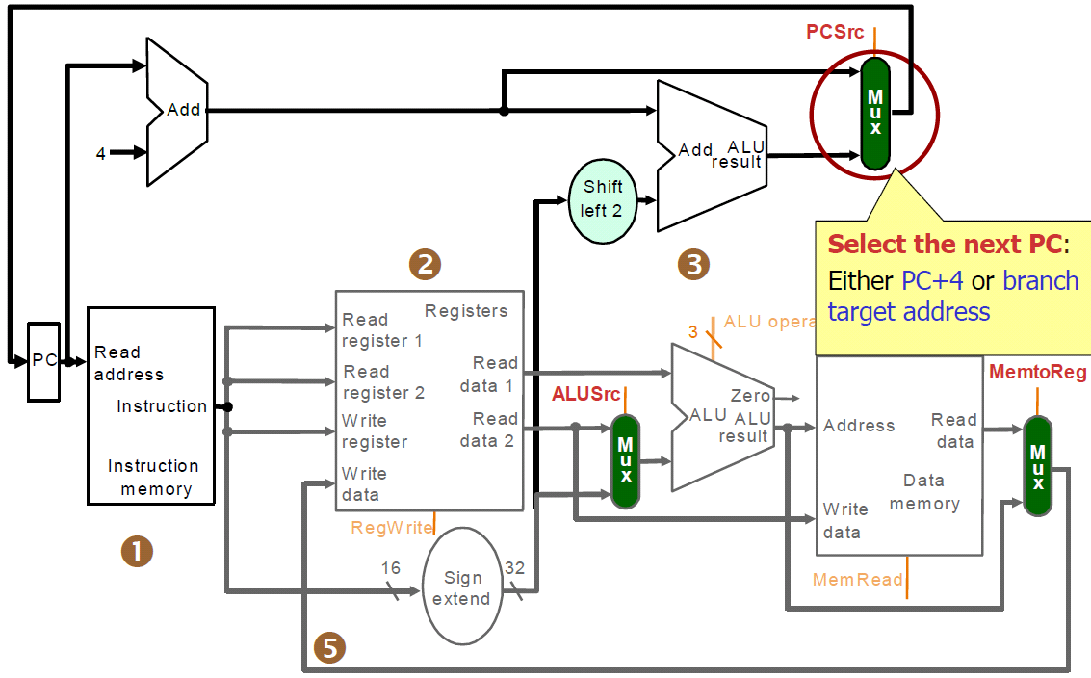
Combined Datapath for Different Instr. Classes

Slide 48
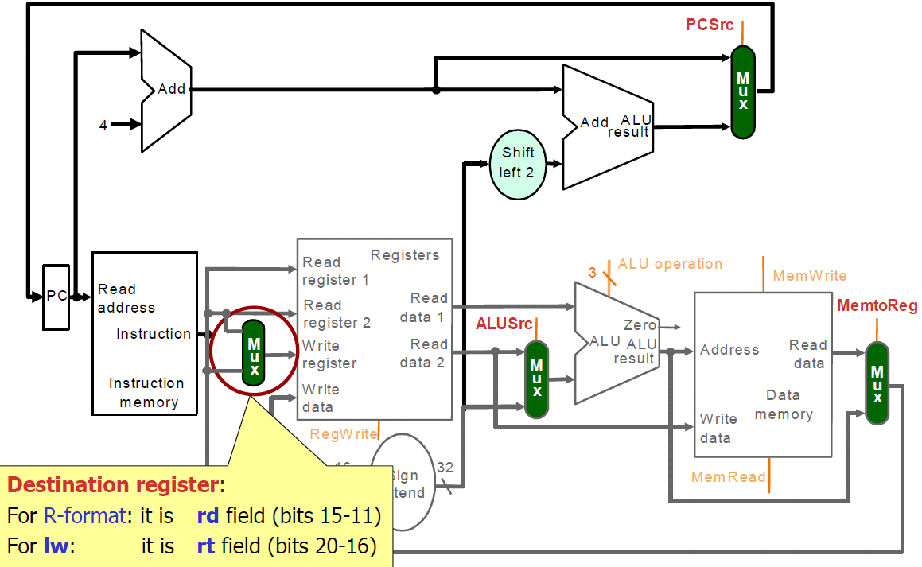
Muxing Two Possible Destination Registers

Slide 49
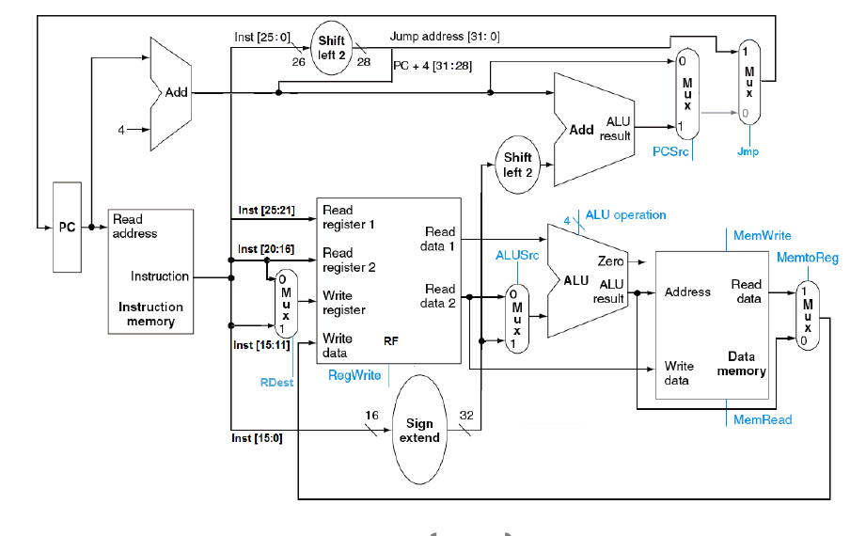
Combining the Datapath for the three format (R, I and J)

